Slide 1
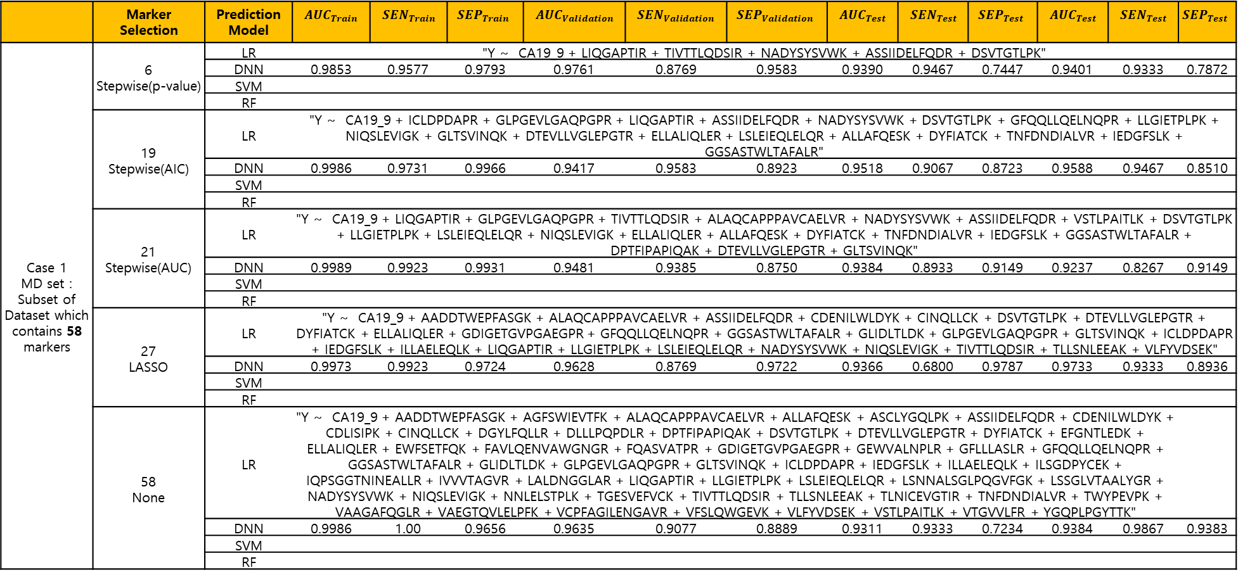
 | Marker Selection | Prediction Model | $$AUC_{Train}$$ | $$SEN_{Train}$$ | $$SEP_{Train}$$ | $$AUC_{Validation}$$ | $$SEN_{Validation}$$ | $$SEP_{Validation}$$ | $$AUC_{Test}$$ | $$SEN_{Test}$$ | $$SEP_{Test}$$ | $$AUC_{Test}$$ | $$SEN_{Test}$$ | $$SEP_{Test}$$
Case 1 MD set : Subset of Dataset which contains 58 markers | 6 Stepwise(p-value) | LR | "Y ~ CA19_9 + LIQGAPTIR + TIVTTLQDSIR + NADYSYSVWK + ASSIIDELFQDR + DSVTGTLPK"
 |  | DNN | 0.9853 | 0.9577 | 0.9793 | 0.9761 | 0.8769 | 0.9583 | 0.9390 | 0.9467 | 0.7447 | 0.9401 | 0.9333 | 0.7872
 |  | SVM
 |  | RF
 | 19 Stepwise(AIC) | LR | "Y ~ CA19_9 + ICLDPDAPR + GLPGEVLGAQPGPR + LIQGAPTIR + ASSIIDELFQDR + NADYSYSVWK + DSVTGTLPK + GFQQLLQELNQPR + LLGIETPLPK + NIQSLEVIGK + GLTSVINQK + DTEVLLVGLEPGTR + ELLALIQLER + LSLEIEQLELQR + ALLAFQESK + DYFIATCK + TNFDNDIALVR + IEDGFSLK + GGSASTWLTAFALR"
 |  | DNN | 0.9986 | 0.9731 | 0.9966 | 0.9417 | 0.9583 | 0.8923 | 0.9518 | 0.9067 | 0.8723 | 0.9588 | 0.9467 | 0.8510
 |  | SVM
 |  | RF
 | 21 Stepwise(AUC) | LR | "Y ~ CA19_9 + LIQGAPTIR + GLPGEVLGAQPGPR + TIVTTLQDSIR + ALAQCAPPPAVCAELVR + NADYSYSVWK + ASSIIDELFQDR + VSTLPAITLK + DSVTGTLPK + LLGIETPLPK + LSLEIEQLELQR + NIQSLEVIGK + ELLALIQLER + ALLAFQESK + DYFIATCK + TNFDNDIALVR + IEDGFSLK + GGSASTWLTAFALR + DPTFIPAPIQAK + DTEVLLVGLEPGTR + GLTSVINQK"
 |  | DNN | 0.9989 | 0.9923 | 0.9931 | 0.9481 | 0.9385 | 0.8750 | 0.9384 | 0.8933 | 0.9149 | 0.9237 | 0.8267 | 0.9149
 |  | SVM
 |  | RF
 | 27 LASSO | LR | "Y ~ CA19_9 + AADDTWEPFASGK + ALAQCAPPPAVCAELVR + ASSIIDELFQDR + CDENILWLDYK + CINQLLCK + DSVTGTLPK + DTEVLLVGLEPGTR + DYFIATCK + ELLALIQLER + GDIGETGVPGAEGPR + GFQQLLQELNQPR + GGSASTWLTAFALR + GLIDLTLDK + GLPGEVLGAQPGPR + GLTSVINQK + ICLDPDAPR + IEDGFSLK + ILLAELEQLK + LIQGAPTIR + LLGIETPLPK + LSLEIEQLELQR + NADYSYSVWK + NIQSLEVIGK + TIVTTLQDSIR + TLLSNLEEAK + VLFYVDSEK"
 |  | DNN | 0.9973 | 0.9923 | 0.9724 | 0.9628 | 0.8769 | 0.9722 | 0.9366 | 0.6800 | 0.9787 | 0.9733 | 0.9333 | 0.8936
 |  | SVM
 |  | RF
 | 58 None | LR | "Y ~ CA19_9 + AADDTWEPFASGK + AGFSWIEVTFK + ALAQCAPPPAVCAELVR + ALLAFQESK + ASCLYGQLPK + ASSIIDELFQDR + CDENILWLDYK + CDLISIPK + CINQLLCK + DGYLFQLLR + DLLLPQPDLR + DPTFIPAPIQAK + DSVTGTLPK + DTEVLLVGLEPGTR + DYFIATCK + EFGNTLEDK + ELLALIQLER + EWFSETFQK + FAVLQENVAWGNGR + FQASVATPR + GDIGETGVPGAEGPR + GEWVALNPLR + GFLLLASLR + GFQQLLQELNQPR + GGSASTWLTAFALR + GLIDLTLDK + GLPGEVLGAQPGPR + GLTSVINQK + ICLDPDAPR + IEDGFSLK + ILLAELEQLK + ILSGDPYCEK + IQPSGGTNINEALLR + IVVVTAGVR + LALDNGGLAR + LIQGAPTIR + LLGIETPLPK + LSLEIEQLELQR + LSNNALSGLPQGVFGK + LSSGLVTAALYGR + NADYSYSVWK + NIQSLEVIGK + NNLELSTPLK + TGESVEFVCK + TIVTTLQDSIR + TLLSNLEEAK + TLNICEVGTIR + TNFDNDIALVR + TWYPEVPK + VAAGAFQGLR + VAEGTQVLELPFK + VCPFAGILENGAVR + VFSLQWGEVK + VLFYVDSEK + VSTLPAITLK + VTGVVLFR + YGQPLPGYTTK"
 |  | DNN | 0.9986 | 1.00 | 0.9656 | 0.9635 | 0.9077 | 0.8889 | 0.9311 | 0.9333 | 0.7234 | 0.9384 | 0.9867 | 0.9383
 |  | SVM
 |  | RF

Slide 2
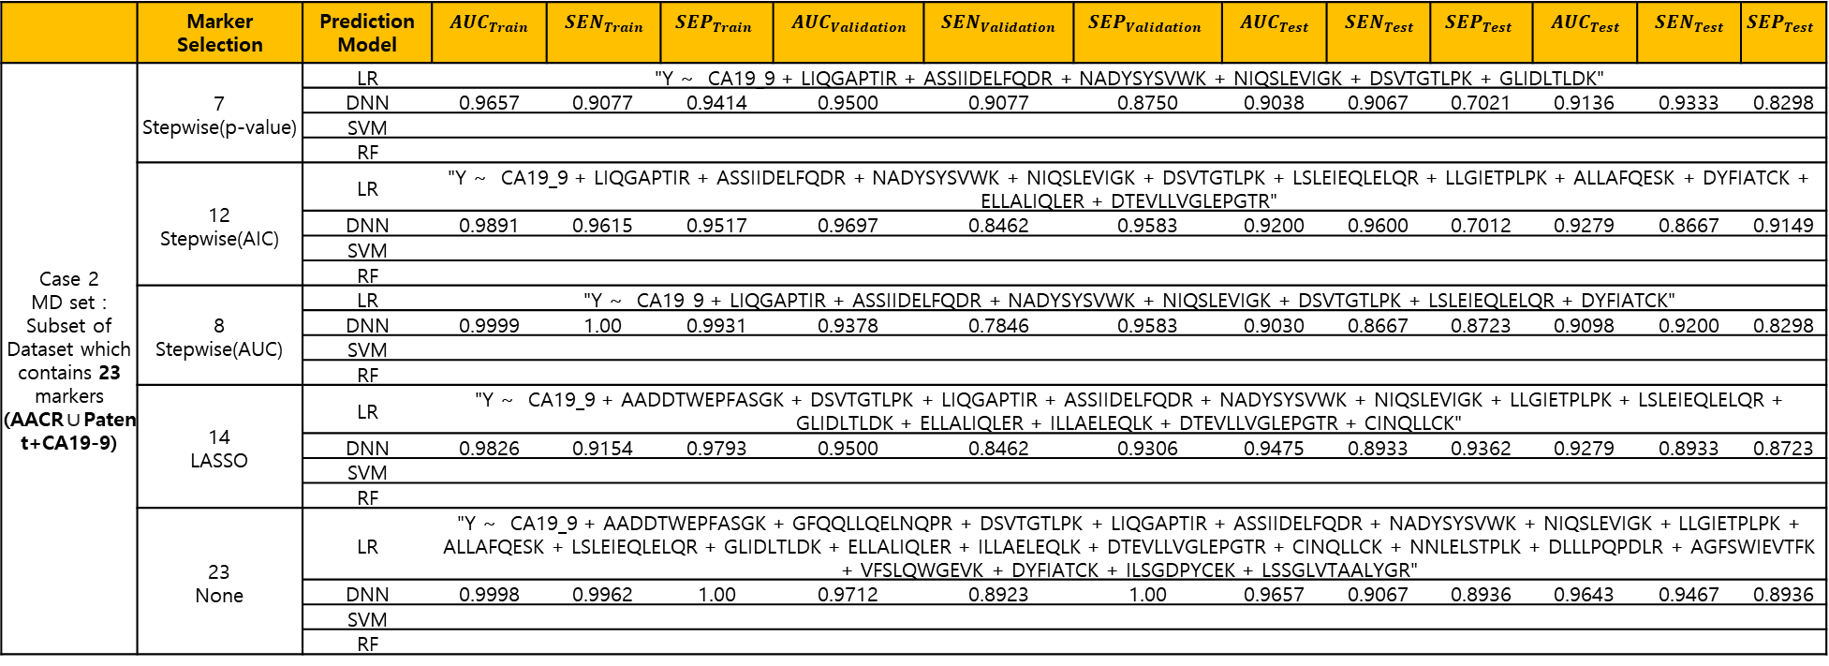
 | Marker Selection | Prediction Model | $$AUC_{Train}$$ | $$SEN_{Train}$$ | $$SEP_{Train}$$ | $$AUC_{Validation}$$ | $$SEN_{Validation}$$ | $$SEP_{Validation}$$ | $$AUC_{Test}$$ | $$SEN_{Test}$$ | $$SEP_{Test}$$ | $$AUC_{Test}$$ | $$SEN_{Test}$$ | $$SEP_{Test}$$
Case 2 MD set : Subset of Dataset which contains 23 markers (AACR∪Patent+CA19-9) | 7 Stepwise(p-value) | LR | "Y ~ CA19_9 + LIQGAPTIR + ASSIIDELFQDR + NADYSYSVWK + NIQSLEVIGK + DSVTGTLPK + GLIDLTLDK"
 |  | DNN | 0.9657 | 0.9077 | 0.9414 | 0.9500 | 0.9077 | 0.8750 | 0.9038 | 0.9067 | 0.7021 | 0.9136 | 0.9333 | 0.8298
 |  | SVM
 |  | RF
 | 12 Stepwise(AIC) | LR | "Y ~ CA19_9 + LIQGAPTIR + ASSIIDELFQDR + NADYSYSVWK + NIQSLEVIGK + DSVTGTLPK + LSLEIEQLELQR + LLGIETPLPK + ALLAFQESK + DYFIATCK + ELLALIQLER + DTEVLLVGLEPGTR"
 |  | DNN | 0.9891 | 0.9615 | 0.9517 | 0.9697 | 0.8462 | 0.9583 | 0.9200 | 0.9600 | 0.7012 | 0.9279 | 0.8667 | 0.9149
 |  | SVM
 |  | RF
 | 8 Stepwise(AUC) | LR | "Y ~ CA19_9 + LIQGAPTIR + ASSIIDELFQDR + NADYSYSVWK + NIQSLEVIGK + DSVTGTLPK + LSLEIEQLELQR + DYFIATCK"
 |  | DNN | 0.9999 | 1.00 | 0.9931 | 0.9378 | 0.7846 | 0.9583 | 0.9030 | 0.8667 | 0.8723 | 0.9098 | 0.9200 | 0.8298
 |  | SVM
 |  | RF
 | 14 LASSO | LR | "Y ~ CA19_9 + AADDTWEPFASGK + DSVTGTLPK + LIQGAPTIR + ASSIIDELFQDR + NADYSYSVWK + NIQSLEVIGK + LLGIETPLPK + LSLEIEQLELQR + GLIDLTLDK + ELLALIQLER + ILLAELEQLK + DTEVLLVGLEPGTR + CINQLLCK"
 |  | DNN | 0.9826 | 0.9154 | 0.9793 | 0.9500 | 0.8462 | 0.9306 | 0.9475 | 0.8933 | 0.9362 | 0.9279 | 0.8933 | 0.8723
 |  | SVM
 |  | RF
 | 23 None | LR | "Y ~ CA19_9 + AADDTWEPFASGK + GFQQLLQELNQPR + DSVTGTLPK + LIQGAPTIR + ASSIIDELFQDR + NADYSYSVWK + NIQSLEVIGK + LLGIETPLPK + ALLAFQESK + LSLEIEQLELQR + GLIDLTLDK + ELLALIQLER + ILLAELEQLK + DTEVLLVGLEPGTR + CINQLLCK + NNLELSTPLK + DLLLPQPDLR + AGFSWIEVTFK + VFSLQWGEVK + DYFIATCK + ILSGDPYCEK + LSSGLVTAALYGR"
 |  | DNN | 0.9998 | 0.9962 | 1.00 | 0.9712 | 0.8923 | 1.00 | 0.9657 | 0.9067 | 0.8936 | 0.9643 | 0.9467 | 0.8936
 |  | SVM
 |  | RF

Slide 3
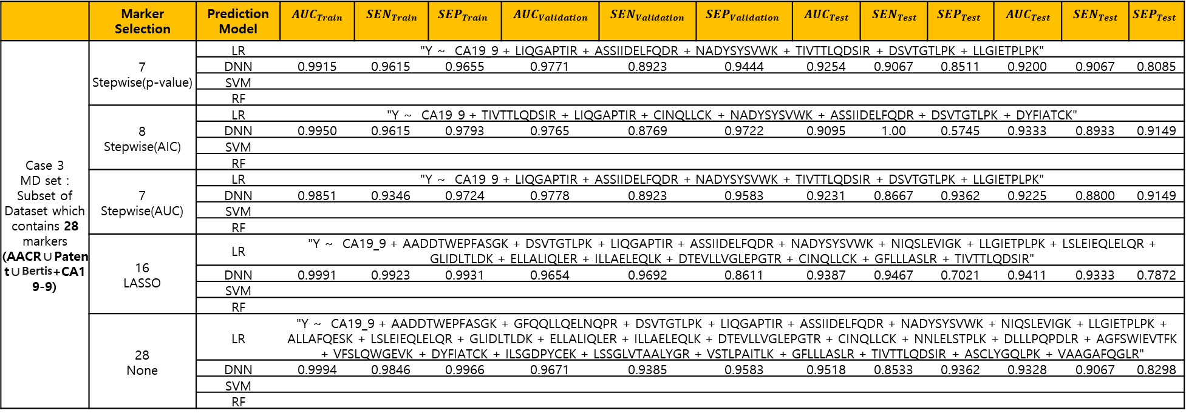
 | Marker Selection | Prediction Model | $$AUC_{Train}$$ | $$SEN_{Train}$$ | $$SEP_{Train}$$ | $$AUC_{Validation}$$ | $$SEN_{Validation}$$ | $$SEP_{Validation}$$ | $$AUC_{Test}$$ | $$SEN_{Test}$$ | $$SEP_{Test}$$ | $$AUC_{Test}$$ | $$SEN_{Test}$$ | $$SEP_{Test}$$
Case 3 MD set : Subset of Dataset which contains 28 markers (AACR∪Patent∪Bertis+CA19-9) | 7 Stepwise(p-value) | LR | "Y ~ CA19_9 + LIQGAPTIR + ASSIIDELFQDR + NADYSYSVWK + TIVTTLQDSIR + DSVTGTLPK + LLGIETPLPK"
 |  | DNN | 0.9915 | 0.9615 | 0.9655 | 0.9771 | 0.8923 | 0.9444 | 0.9254 | 0.9067 | 0.8511 | 0.9200 | 0.9067 | 0.8085
 |  | SVM
 |  | RF
 | 8 Stepwise(AIC) | LR | "Y ~ CA19_9 + TIVTTLQDSIR + LIQGAPTIR + CINQLLCK + NADYSYSVWK + ASSIIDELFQDR + DSVTGTLPK + DYFIATCK"
 |  | DNN | 0.9950 | 0.9615 | 0.9793 | 0.9765 | 0.8769 | 0.9722 | 0.9095 | 1.00 | 0.5745 | 0.9333 | 0.8933 | 0.9149
 |  | SVM
 |  | RF
 | 7 Stepwise(AUC) | LR | "Y ~ CA19_9 + LIQGAPTIR + ASSIIDELFQDR + NADYSYSVWK + TIVTTLQDSIR + DSVTGTLPK + LLGIETPLPK"
 |  | DNN | 0.9851 | 0.9346 | 0.9724 | 0.9778 | 0.8923 | 0.9583 | 0.9231 | 0.8667 | 0.9362 | 0.9225 | 0.8800 | 0.9149
 |  | SVM
 |  | RF
 | 16 LASSO | LR | "Y ~ CA19_9 + AADDTWEPFASGK + DSVTGTLPK + LIQGAPTIR + ASSIIDELFQDR + NADYSYSVWK + NIQSLEVIGK + LLGIETPLPK + LSLEIEQLELQR + GLIDLTLDK + ELLALIQLER + ILLAELEQLK + DTEVLLVGLEPGTR + CINQLLCK + GFLLLASLR + TIVTTLQDSIR"
 |  | DNN | 0.9991 | 0.9923 | 0.9931 | 0.9654 | 0.9692 | 0.8611 | 0.9387 | 0.9467 | 0.7021 | 0.9411 | 0.9333 | 0.7872
 |  | SVM
 |  | RF
 | 28 None | LR | "Y ~ CA19_9 + AADDTWEPFASGK + GFQQLLQELNQPR + DSVTGTLPK + LIQGAPTIR + ASSIIDELFQDR + NADYSYSVWK + NIQSLEVIGK + LLGIETPLPK + ALLAFQESK + LSLEIEQLELQR + GLIDLTLDK + ELLALIQLER + ILLAELEQLK + DTEVLLVGLEPGTR + CINQLLCK + NNLELSTPLK + DLLLPQPDLR + AGFSWIEVTFK + VFSLQWGEVK + DYFIATCK + ILSGDPYCEK + LSSGLVTAALYGR + VSTLPAITLK + GFLLLASLR + TIVTTLQDSIR + ASCLYGQLPK + VAAGAFQGLR"
 |  | DNN | 0.9994 | 0.9846 | 0.9966 | 0.9671 | 0.9385 | 0.9583 | 0.9518 | 0.8533 | 0.9362 | 0.9328 | 0.9067 | 0.8298
 |  | SVM
 |  | RF

